Slide 1
Fine Art Subject Guide
Bibliography Refresh Proposal

Slide 2
Current Fine Art Subject Guide
Bibliography

Slide 3
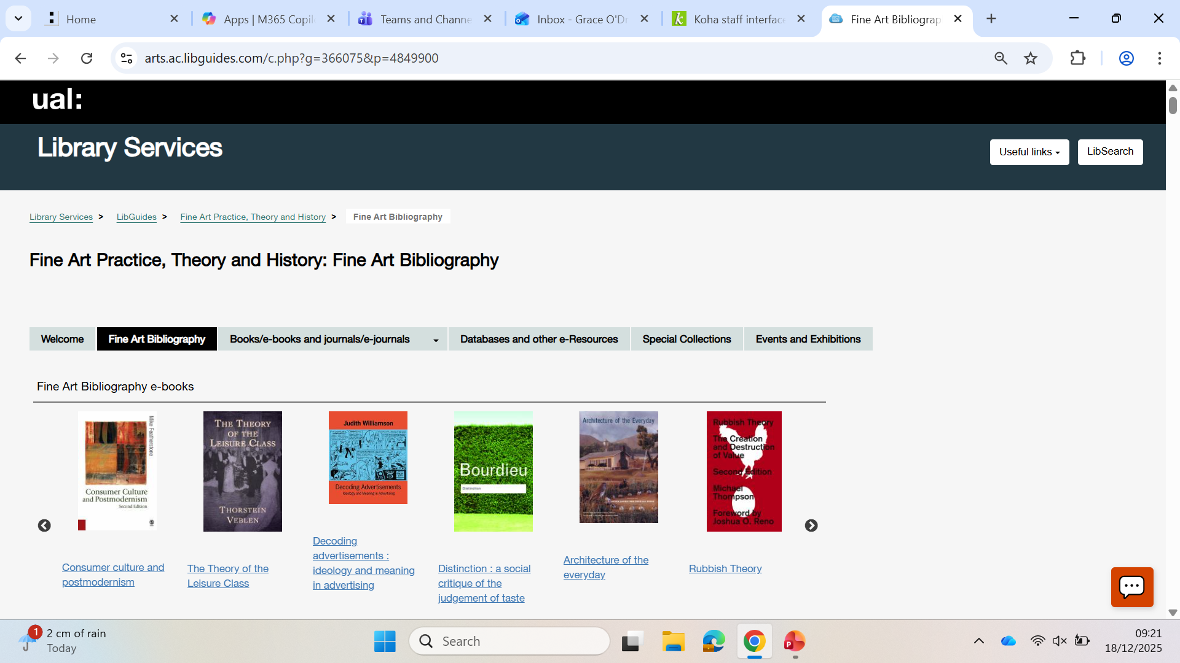
Current bibliography page position and opening view

Slide 4
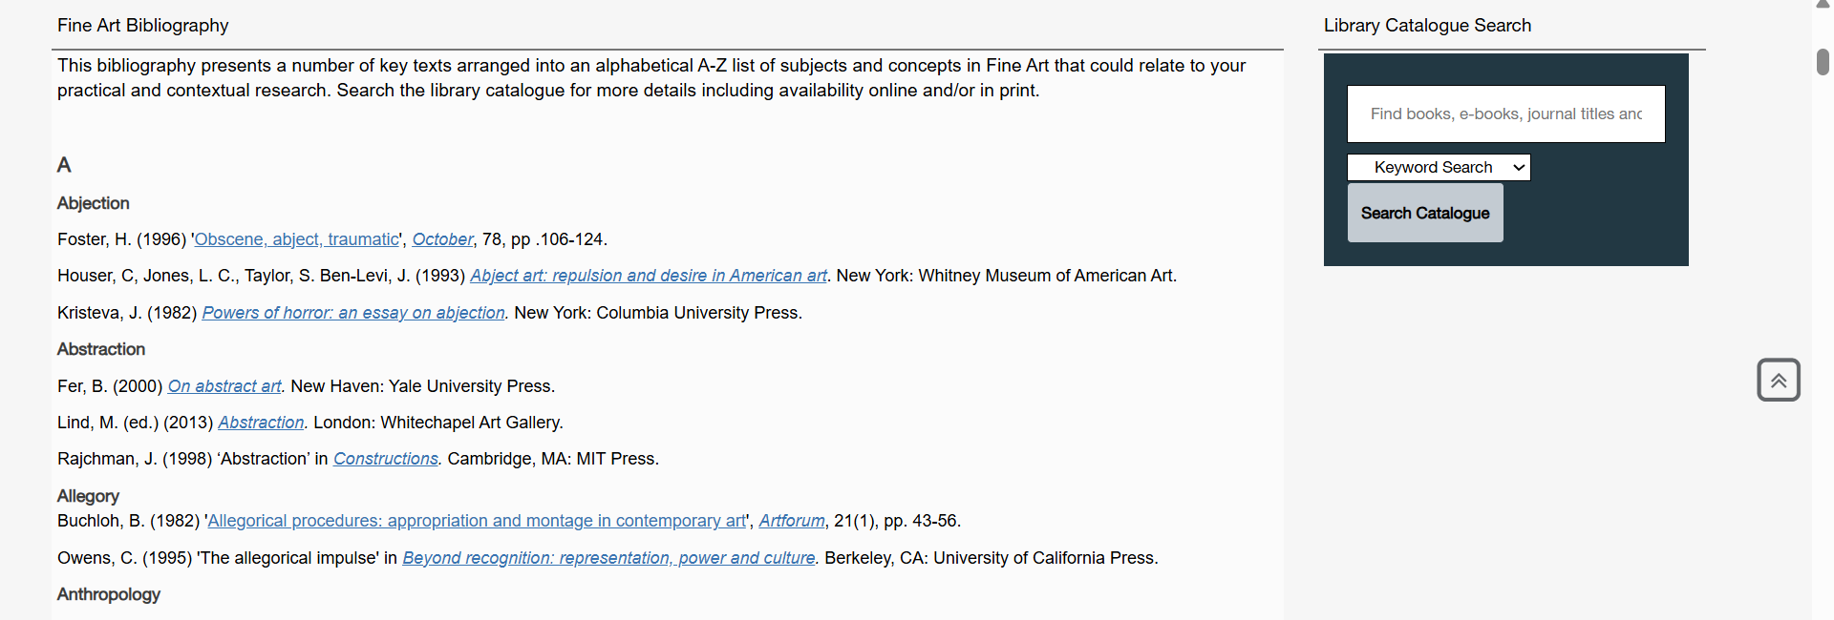
Current bibliography page main page format – scrolling down

Slide 5
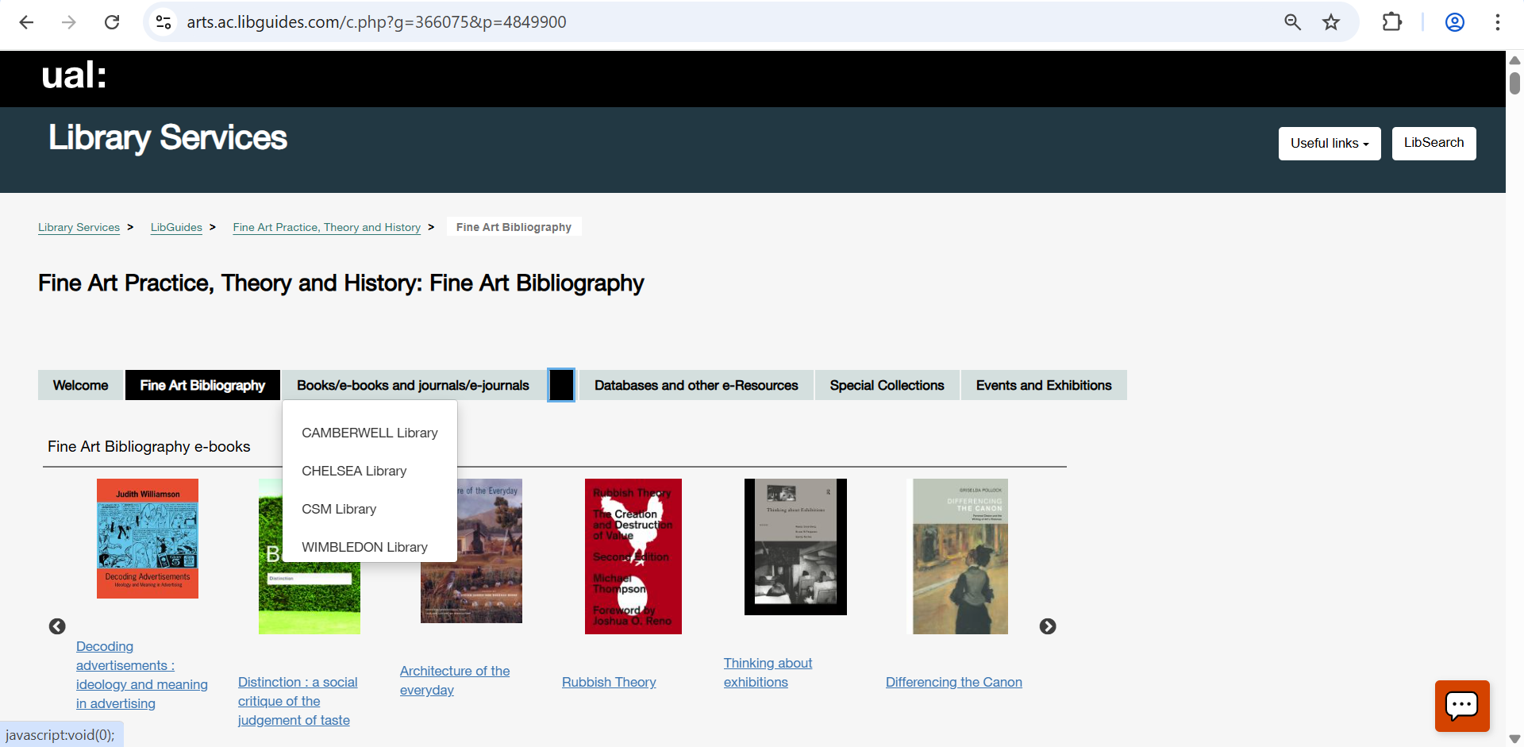
Site specific pages menu is listed as books / e-books journals / e-journals

Slide 6
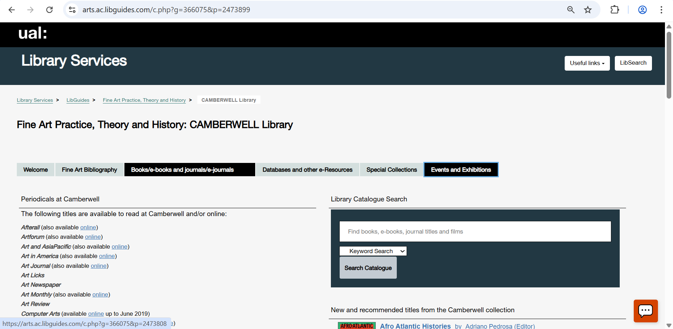
Site specific pages menu is listed as books / e-books journals / e-journals (CCA page is out of date and non-visual)

Slide 7
Proposed Fine Art Subject Guide
Bibliography

Slide 8
Propose to update the page sections and page headings comprising the FA Subject Guide – introducing ‘starting research’
Draft revised headings / sections
Starting Research
Fine Art Bibliography by Subject
Online Resources
UAL Special Collections
Events & Exhibitions
Section | Content
Starting Research | Carousels approx. 30+ titles, key series, disciplines, theory, social justice themes (selected by most borrowed, contemporary and diversity)
Bibliography | Remove ebooks carousel, add themes – focus on social justice
Online Resources | Add and expand e-books carousel, update all other info
Special Collections | Update with access info and digital collections
Events and Exhibitions | Review and update
Draft revised sections content

Slide 9
Proposed content for Starting Research page – all content to be displayed as carousel book covers
Research start points
Carousels of approx. 30+ titles, to include:
Key series
Practice Disciplines
Art theory
Theory
Social justices (art lens)
(selected by most borrowed, plus contemporary and diverse authors)
Starting Research
Whitechapel Documents of Contemporary Art

Slide 10
Proposed changes to Bibliography page – update or remove the ebooks carousel
Starting Research
Fine Art Bibliography by Subject
Replicate this carousel in e-resources and add missing titles listed below in the main text

Slide 11
Proposed changes to Bibliography page – clarify the intro text for how to use, add more helpful info to the search box text
Expand explanation
Starting Research
Fine Art Bibliography by Subject
Update

Slide 12
Proposed changes to Bibliography page – add missing Social Justice research support sections, collaborate with dissertation leads for student facing input
Starting Research
Fine Art Bibliography by Subject
++ Add sections

Slide 13
Remove this site-by-site page TBC
Add a classmarks guide to the bottom of ‘starting research’

